Slide 1

Functional analysis
Víctor Jiménez-Jiménez
vjimenezj@cnic.es

Slide 2
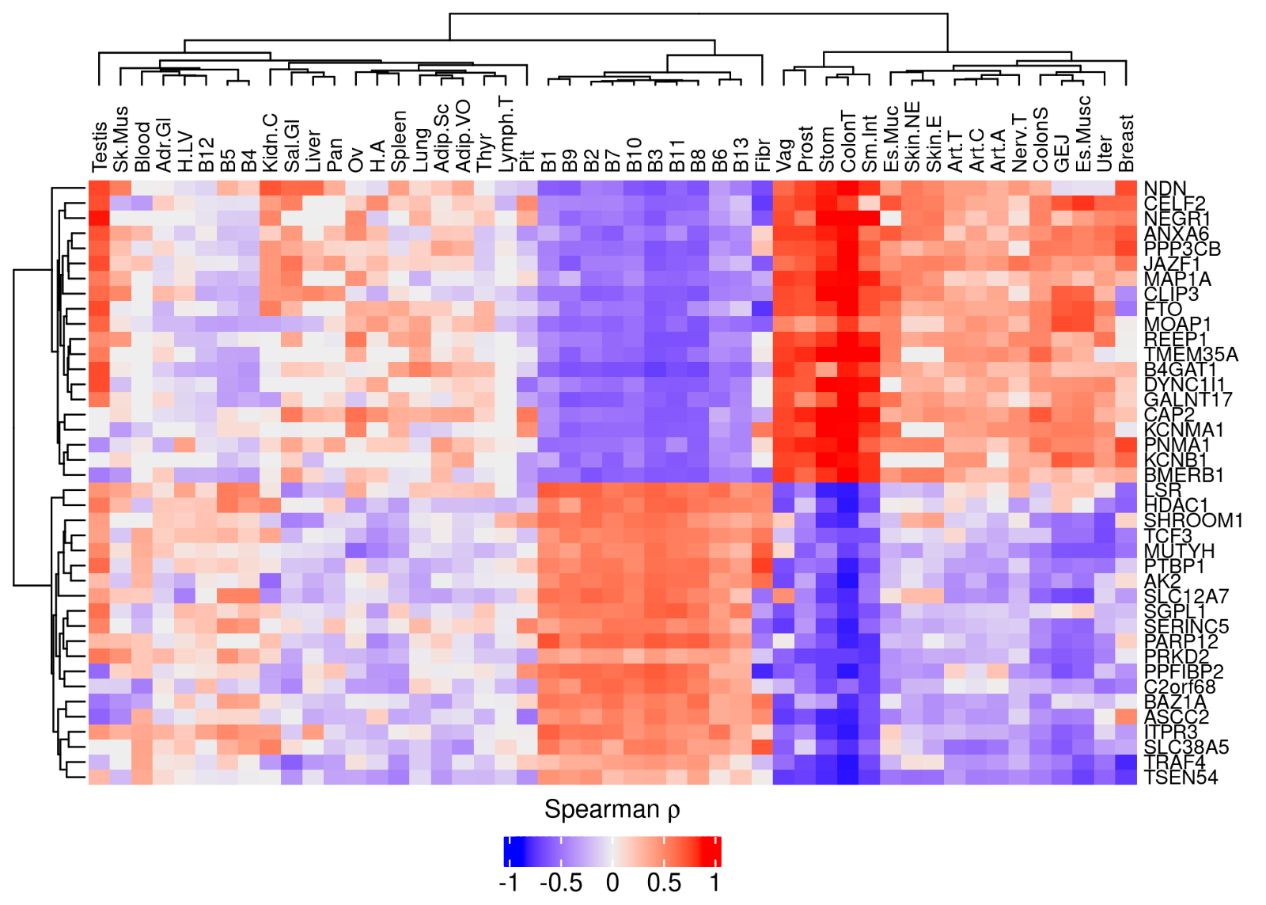
Why functional analysis?
Description/Interpretation
Hypothesis formulation:
  Mechanisms (pathways/TFs involved)
  Drugs with similar/opposing effects
  Input
Overrepresentation analysis (ORA)
Functional class scoring methods (FCS)
Pathway topology-based methods (PT-based methods)
Database

Slide 3
Data
Ranked list of gene statistics associated to gene IDs
Set of gene IDs

Slide 4
Data
Ranked list of gene statistics associated to gene IDs
1) FCS
2) PT-based methods
Set of gene IDs
1) ORA
2) PT-based methods

Slide 5
Data
Ranked list of gene statistics associated to gene IDs
1) FCS
2) PT-based methods
Selection criteria (adjusted p-value)
Set of gene IDs
1) ORA
2) PT-based methods

Slide 6
Data
1) FCS
2) PT-based methods
**ATTENTION: Gene name conventions!! (RefSeq/GENECODE versions)
**Filtering has a significant effect on results
Ranked list of gene statistics associated to gene IDs
Selection criteria (adjusted p-value)
Set of gene IDs
1) ORA
2) PT-based methods

Slide 7
Annotation databases
Structured compendium of prior knowledge: Gene categorization
Capture different type of information:
  Ontologies: Function, structure, localization,…
  Pathways
  Regulation
  Perturbation experiments
  Protein-protein interactions
Continuous update and reannotation
** Election based on study purpose

Slide 8
Broad Molecular Signatures Database (MSigDB)
H: Hallmark gene sets
  - Specific, highly curated (few genes)
  - Computationally defined
C1: positional gene sets
  - Based on each cytogenetic band
C2: curated gene sets
  Chemical-genetic perturbations (CGP)
  Canonical pathways (CP)
    KEGG
    REACTOME
    BIOCARTA
    PID
    Wikipathways

Slide 9
Broad Molecular Signatures Database (MSigDB)
C3: regulatory target gene sets
  miRDB subset of MIR (miRDB v6.0 algorithm)
  MIR_Legacy subset of MIR (older, putative target sites)
  GTRD subset of TFT (based on TFBS signatures)
  TFT_Legacy subset of TFT (older predictions)
C4: computational gene sets
  CGN: cancer gene neighbourhoods
  CM: cancer modules

Slide 10
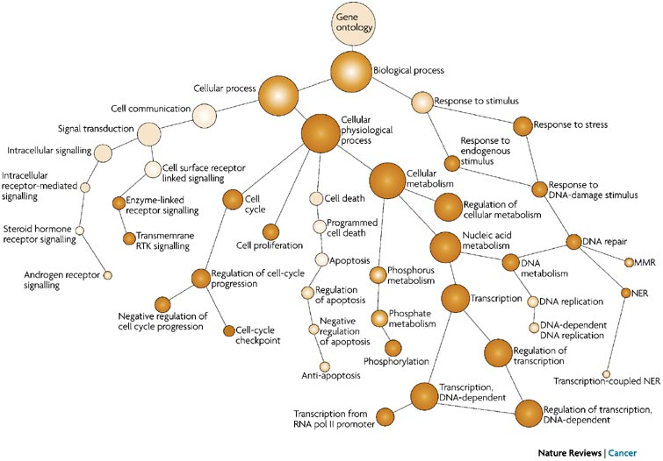
Broad Molecular Signatures Database (MSigDB)
C5: ontology gene sets
  GO:BP – Gene Ontology Biological Process
  GO:MF – Gene Ontology Molecular Function
  GO:CC – Gene Ontology Cellular Component
-Hierarchical organization (parent-child)
-Highly dependent on prior research

Slide 11
Broad Molecular Signatures Database (MSigDB)
C6: oncogenic signature gene sets (experimental data)
C7: immunologic signature gene sets
  ImmuneSigDB subset of C7 (Chemical/genetic perturbations of the immune system)
  VAX: vaccine reponse gene sets (Human Immunology Project Consortium, HIPC, human transcriptomic immune response to vaccination)
C8: cell type signature gene sets (based on single-cell data)

Slide 12
Database selection criteria to consider
Biological aspects captured by the database
Update frequency
Degree of redundancy and overlap
  Genes are commonly not exclusive (one same gene in many sets) – PADOG
  Number of gene sets – Affect multiple correction methods
Size of the gene sets

Slide 13
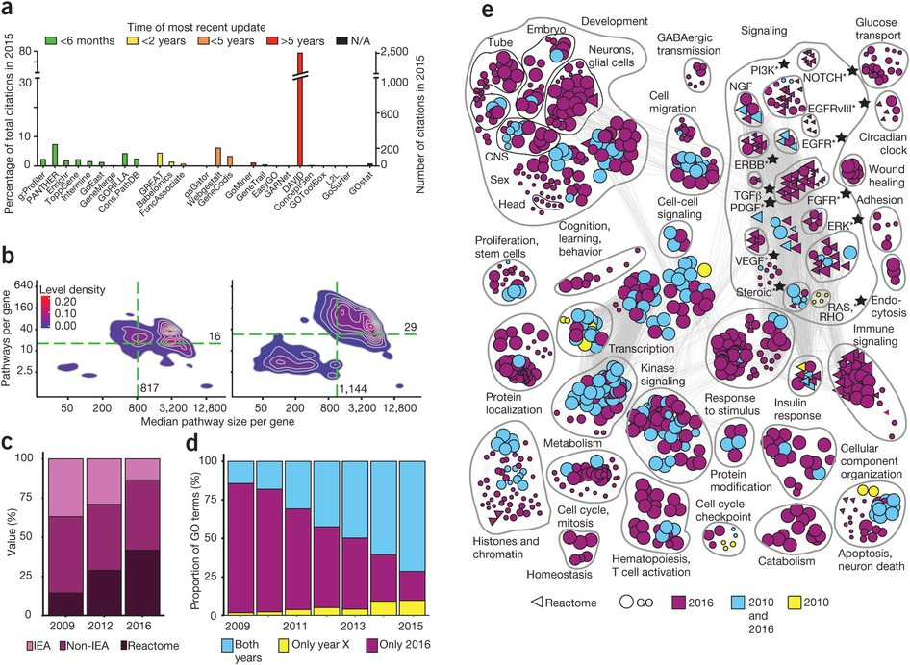
Wadi, L., Meyer, M., Weiser, J. et al. Impact of outdated gene annotations on pathway enrichment analysis. Nat Methods 13, 705–706 (2016). https://doi.org/10.1038/nmeth.3963

Slide 14
Functional analysis
  Input
Overrepresentation analysis (ORA)
Functional class scoring methods (FCS)
Pathway topology-based methods (PT-based methods)
Database

Slide 15
Overrepresentation analysis (ORA)
Applied to gene lists (DEGs, coregulated gene clusters,…)
Mathematical foundations: Fisher’s exact test (Hypergeometric test)
  - Are there significantly more genes of a given gene set in my selected list than the ones expected by chance?
 | Genes in the list | Genes in the background
That belong to the gene set | k | n
That do not belong to the gene set | K-k | N-n
N: Background genes
K: Gene list
k: genes of the gene set in gene list K
n: genes of the gene set in the background N

Slide 16
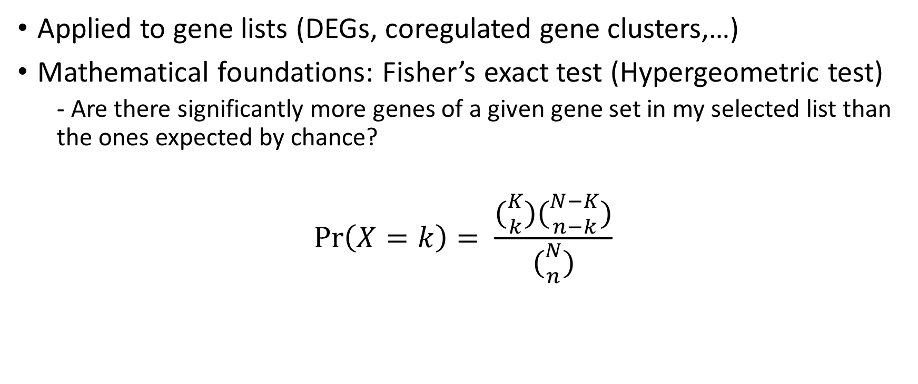
Overrepresentation analysis (ORA)
Applied to gene lists (DEGs, coregulated gene clusters,…)
Mathematical foundations: Fisher’s exact test (Hypergeometric test)
  - Are there significantly more genes of a given gene set in my selected list than the ones expected by chance?
$$\operatorname{Pr}\left(X=k\right)= \frac{({K \atop k})({N−K \atop n−k})}{({N \atop n})}$$
N: Background genes
K: Gene list
k: genes of the gene set in gene list K
n: genes of the gene set in the background N

Slide 17

Overrepresentation analysis (ORA)
$\operatorname{Pr}\left(X>k\right)$ = 1 - $\operatorname{Pr}\left(X<k\right)=1 − \sum_{i=0}^{k}{\operatorname{Pr}\left(X=i\right)}$
$$\operatorname{Pr}\left(X=i\right)= \frac{({K \atop i})({N−K \atop n−i})}{({N \atop n})}$$
** Can be approximated by the χ² test for large enough values of k

Slide 18
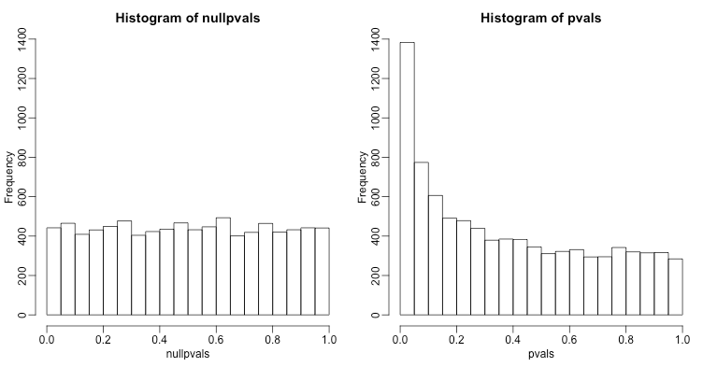
Multiple testing correction
Bonferroni: Dividing by the number of tests
Benjamini-Hochberg (FDR)

Slide 19
Overrepresentation analysis (ORA)
Not consider positions of directions of genes in pathways
Fisher’s exact test, χ² test, hypergeometric test
Assumes genes are independent
Threshold required (small changes may not be detected)
DAVID, gProfiler, FatiGO, GOstats, GOToolBox, GoMiner, WebGestalt

Slide 20
Practical example with web apps
DAVID: DAVID Functional Annotation Bioinformatics Microarray Analysis (ncifcrf.gov)
gProfiler: g:Profiler – a web server for functional enrichment analysis and conversions of gene lists (ut.ee)

Slide 21
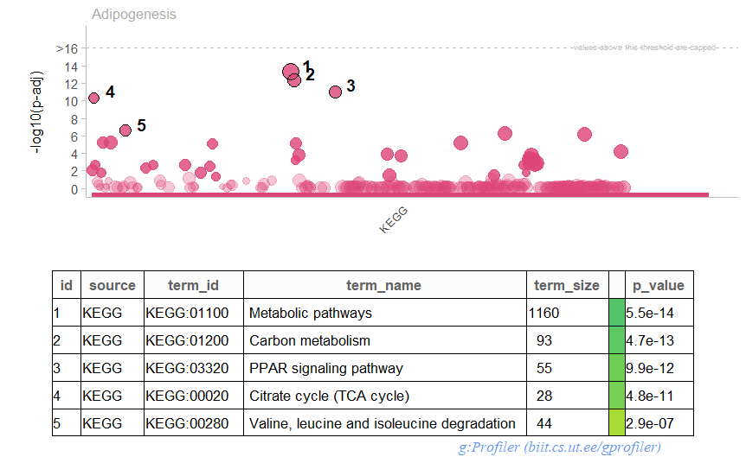
Practical example with R
vjimenezj/TRREP (github.com)
https://github.com/vjimenezj/TRREP

Slide 22
Functional class scoring methods
Sensitive to small but coordinated changes in sets of functionally related genes
Used when is hard to find a significance threshold
GSEA, Catmap, GlobalTest, sigPathway, SAFE, GSA, Category, PADOG, PCOT2, FunCluster, SAM-GS

Slide 23
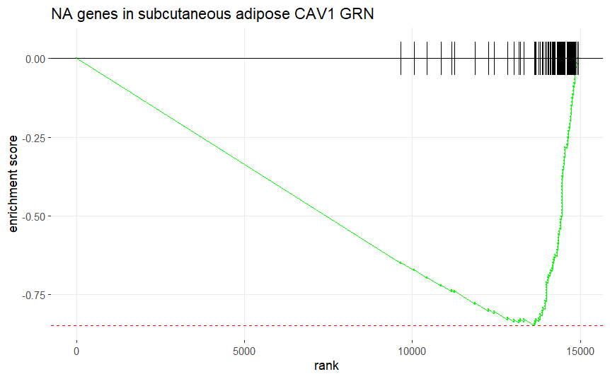
GSEA
Null hypothesis: Rank ordering is random
Sort genes and calculate the running sum (ES)
Permute labels/genes and compute significance

Slide 24
Practical example with GSEA
R coding: fGSEA
vjimenezj/TRREP (github.com)
https://github.com/vjimenezj/TRREP

Slide 25
Pathway topology-based methods – Mathematical fundations
Impact analysis:
  ORA
  Magnitude of the change and relevance in the pathway (position and direction)
  * Changes measured are propagated along the topology of the pathway
ROntoTools, SPIA, cepaORA, cepaGSA, Pathway-Expres, NetGSA, TopoGSA, TopologyGSA, PWEA, PathOlogist, GGEA, PathNet, BLMA

Slide 26
CAUTION!!
High impact of outdated gene annotations on pathway enrichment analysis
Hard to choose the best pathway database and tool
Misinterpretations due to unspecific pathway terms
Requires validation
** Good practice: Include version of DB and tool

Slide 27
Functional analysis
Description/Interpretation
Hypothesis formulation:
  Mechanisms (pathways/TFs involved)
  Drugs with similar/opposing effects
  Input
Overrepresentation analysis (ORA)
Functional class scoring methods (FCS)
Pathway topology-based methods (PT-based methods)
Database

